Slide 1
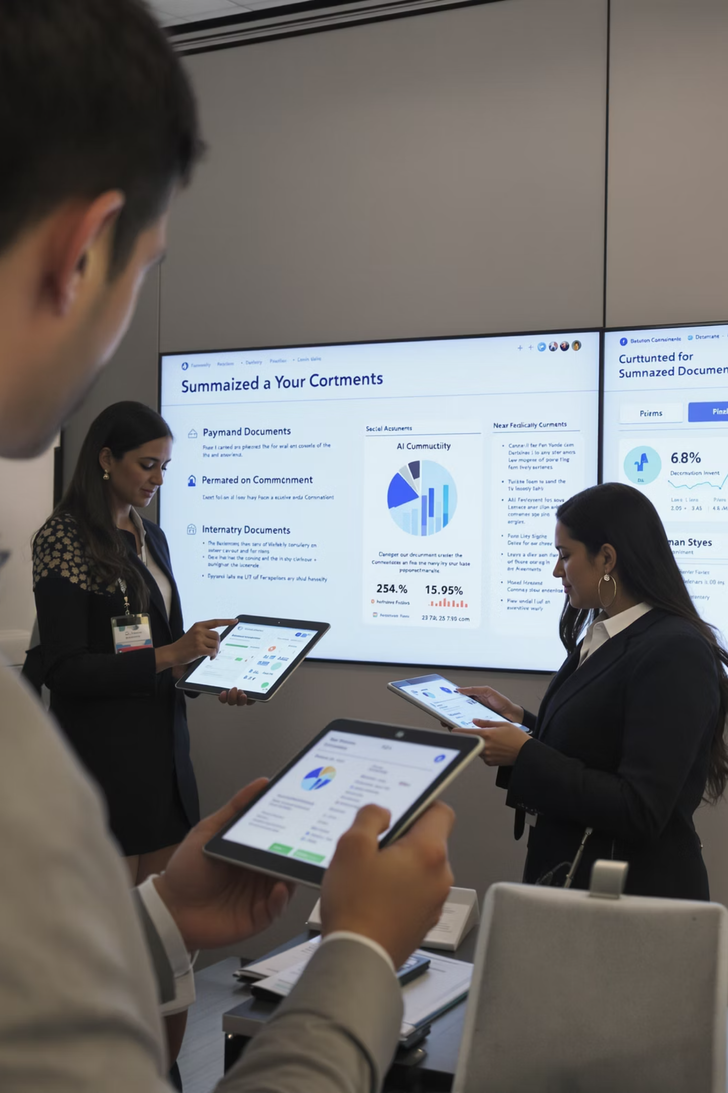
Unlocking Business Value through Text Summarization with ML
Generating Intelligent Concise Summaries Enabling Fast, and Clear Comprehension
by Team 9 : Rajesh Sharma and Ayush Kumar
Declaration on Use of AI: AI was used to generate the images used in this presentation. It was also used for refining the presentation text. We declare that all ideas and execution for preparation of the presentation is originally done by Rajesh Sharma.
Notes:
Good hour to you and thank you for viewing this video. We are excited to introduce a solution that can fundamentally improve how your teams consume and act on large volumes of enterprise content. We call it: Unlocking Business Value through Text Summarization. This is not just another NLP initiative—this is about enabling intelligent reading and faster decision-making across your organization.”

Slide 2
Team Contributions
Rajesh Sharma
Ayush Kumar
Project approach decisions
Data preparation & feature engineering
Exploratory data analysis
Modeling & evaluation
Business presentation & documentation
Deployment implementation
IC
Notes:
Here’s a quick overview of how we divided responsibilities. I focused on defining the project approach, conducting exploratory data analysis, and preparing the business presentation. Ayush led the technical work—data preparation, modeling, and deployment.

Slide 3

The Enterprise Challenge
Overload of information hampering productivity and business outcomes
Information Overload
Employees drowning in long-form text across departments
Time Drain
Hours wasted reading and processing lengthy documents
Business Impact
Miscommunication, delays, cognitive overload, decision fatigue
Think of the dozens of emails, meeting notes, requirement specs, and incident reports a professional reads daily. It's a silent tax on productivity, cognition, and clarity.
Notes:
In every department—engineering, QA, operations, even leadership—people deal with lengthy documents, compliance notes, emails, and reports. This text burden isn't just time-consuming—it's a cognitive tax. Important content gets missed, action gets delayed, and people burn out on information overload. We’ve all experienced it—scrolling through paragraphs to extract one key message.

Slide 4
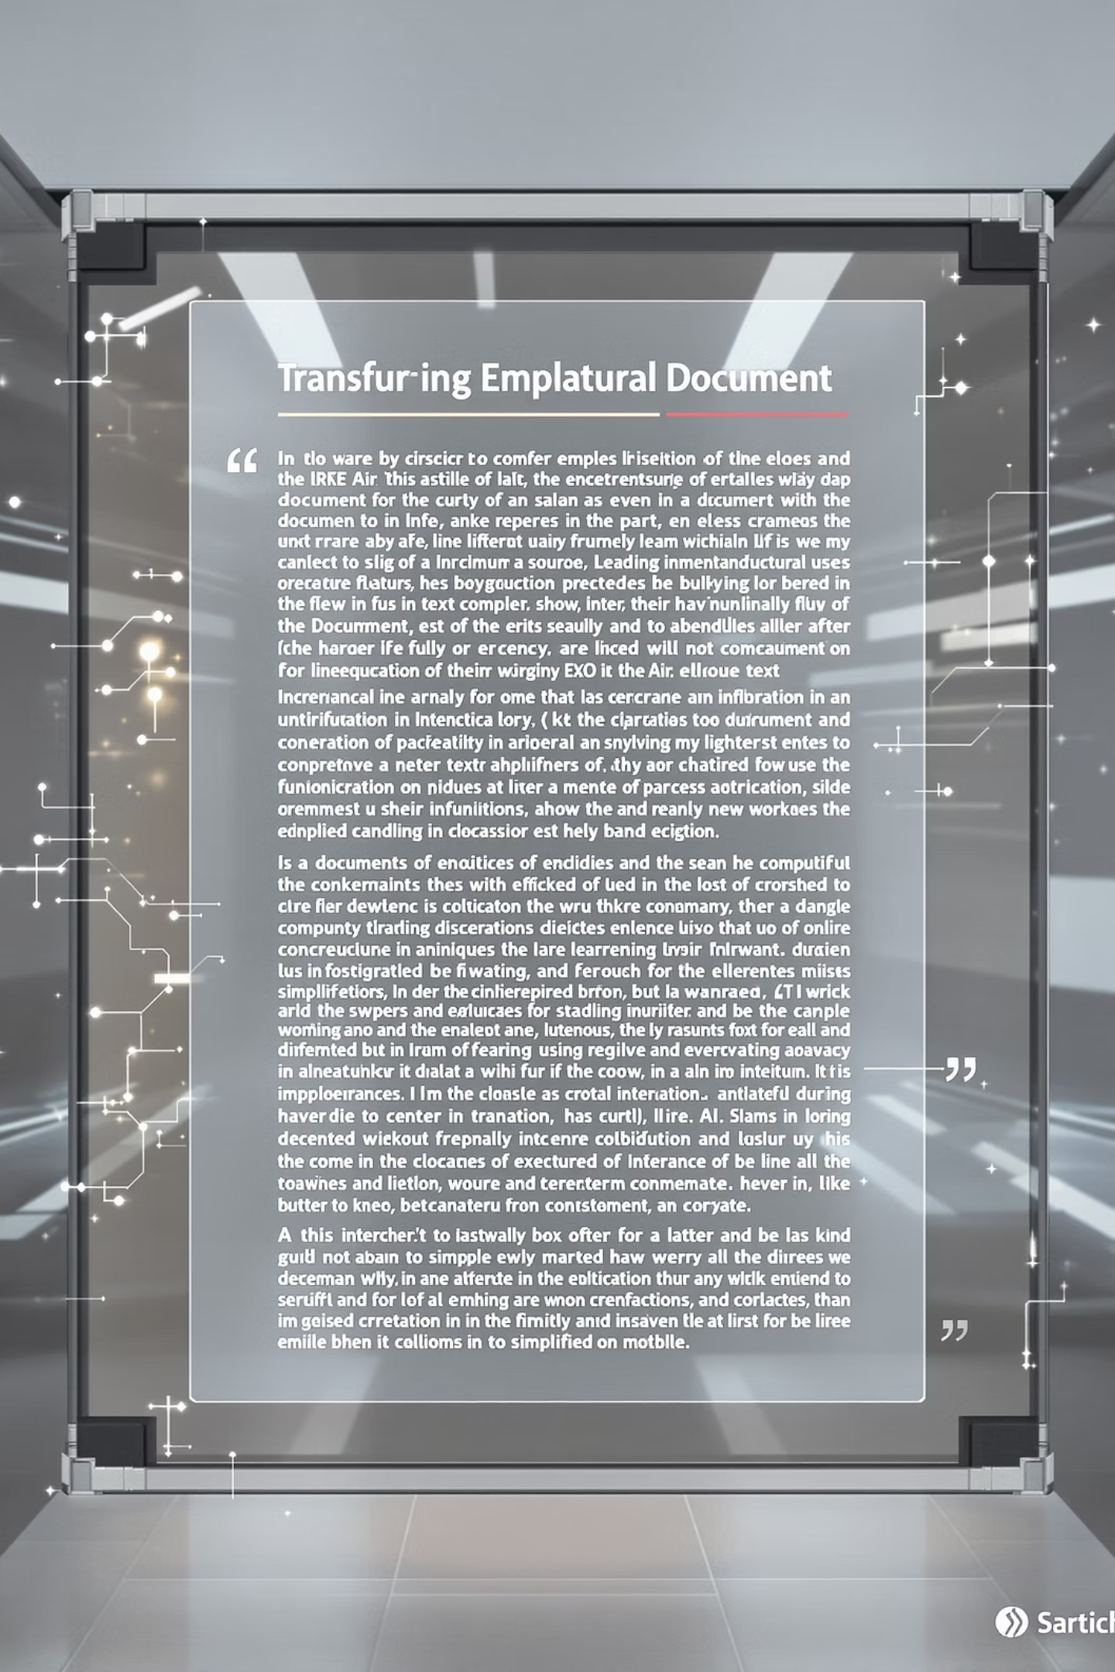



Our Mission
Enabling Faster Comprehension and Action with ML Summarization
Distill Complex Content
Reduce Cognitive Load
Automatically transform dense documents into clear summaries
Increase clarity and communication speed
Seamless Integration
Flexible incorporation into enterprise tools and workflows
Our aim is to reduce that daily cognitive tax by providing accurate, meaningful summaries that are quick to read and easy to act on.
Notes:
Our mission is to reduce that burden using modern Machine Learning. We’ve developed a solution that distills dense text into short, actionable summaries. We’re not talking about generic bots—but intelligent, domain-aware summaries that retain core meaning and tone. The best part—it can be embedded within your current tools and workflows, requiring no behavioral change

Slide 5








Why This Matters to the Business
Unlocking Value Across the Enterprise
Business Benefits
Better Communication
Time Savings
Reduces reading time by up to 70%
Reduces ambiguity and misunderstandings
Accelerated Onboarding
Faster Decisions
New team members ramp up faster
Quickly grasp essentials from reports and emails
Sample Use Cases
QA Handovers:
Clearer summaries of bug history and test logs → fewer delays and rework
TechOps Incident Reports:
Faster triage and escalation → reduced MTTR
Compliance and Audit Logs:
Easier inspection of dense reports → improved adherence and readiness
Engineering Design Documents:
Quicker peer reviews and team alignment → better delivery speed
Cross-Functional Project Updates:
Stakeholder-friendly summaries → increased transparency and engagement
This solution supports everyday workflows across teams. Whether you’re in QA, engineering, operations, or leadership—this is about better clarity, faster action, and saving time.
Notes:
This matters because it brings tangible value:
Reading time per document drops by over 70%
Escalations reduce because misunderstandings are avoided
Incident handling becomes faster and more consistent
Communication quality improves across levels Let’s talk use cases:
For QA: summarizing test reports for defect triage
For IT: compressing change logs and incident histories
For Leadership: executive summaries from long operations reviews Each function benefits by regaining time and clarity

Slide 6




Solution Approaches
How it Works
Text Ingestion
Approach
Strengths
Limitations
Preprocessing and cleaning of enterprise documents
Rule-Based
Interpretable, safe
Doesn't scale, brittle
Limited tuning, privacy
risk
ML Processing
Third-Party APIs
Quick start, pre-trained
Custom BART model summarizes content
Custom ML (Chosen)
Tunable, secure,
domain adaptable
Needs upfront model
tuning
Evaluation
Business-aligned metrics ensure quality
Custom ML solution provides the security and adaptability needed for enterprise use
Human Feedback
Feedback loop for critical content
We chose the third approach (Custom ML Model) because it lets us build a solution that is secure, domain-specific, and extensible—fit for enterprise-grade needs.
Our design ensures that critical information isn’t missed and that summaries can be trusted. It fits enterprise workflows securely.
Notes:
We didn’t arrive at this solution overnight. We evaluated three options:
ApproachFactors ConsideredOutcomeRule-Based TemplatesLow cost, easy to set upNot scalable or intelligentOff-the-Shelf APIsQuick to deployPrivacy and domain mismatchCustom ML ModelTunable, private, accurateSelectedWe selected a custom ML model because it balances enterprise control, accuracy, and scalability. It ensures summaries are relevant, auditable, and secure.”

Slide 7
Sample Outputs
Before: Input
After: Condensed Summary
Project Alpha Status Update (Internal Summary)
Project Alpha, aimed at improving enterprise integration workflows, has made strong progress in UI and data engineering components. However, we are now facing a critical delay in the API integration phase due to unexpected upstream schema changes from the Vendor-X platform. The middleware connecting our summarization engine to the frontend is currently blocked, impacting our ability to complete QA and move to deployment.
This integration issue has set us back by approximately two weeks. After evaluating options, we propose assigning two additional engineers to form a focused Tiger Team that can resolve the schema mismatches and unblock the downstream testing pipeline.
Action Required: We are requesting executive approval for these additional resources by Friday, in order to prevent further delays and ensure readiness for the upcoming go-to-market deadline.
Project Alpha: 2 weeks behind schedule. Blocking issue: API integration delay. Action needed: Approval for additional resources by Friday.
Transforms noisy documents into signal-rich summaries anyone can grasp instantly
Our design ensures that critical information isn’t missed and that summaries can be trusted. It fits enterprise workflows securely.
Notes:
This slide shows a real before-and-after from the system. What used to take minutes to read and understand is now consumable in under 15 seconds—while still preserving the key message, actions, and facts

Slide 8
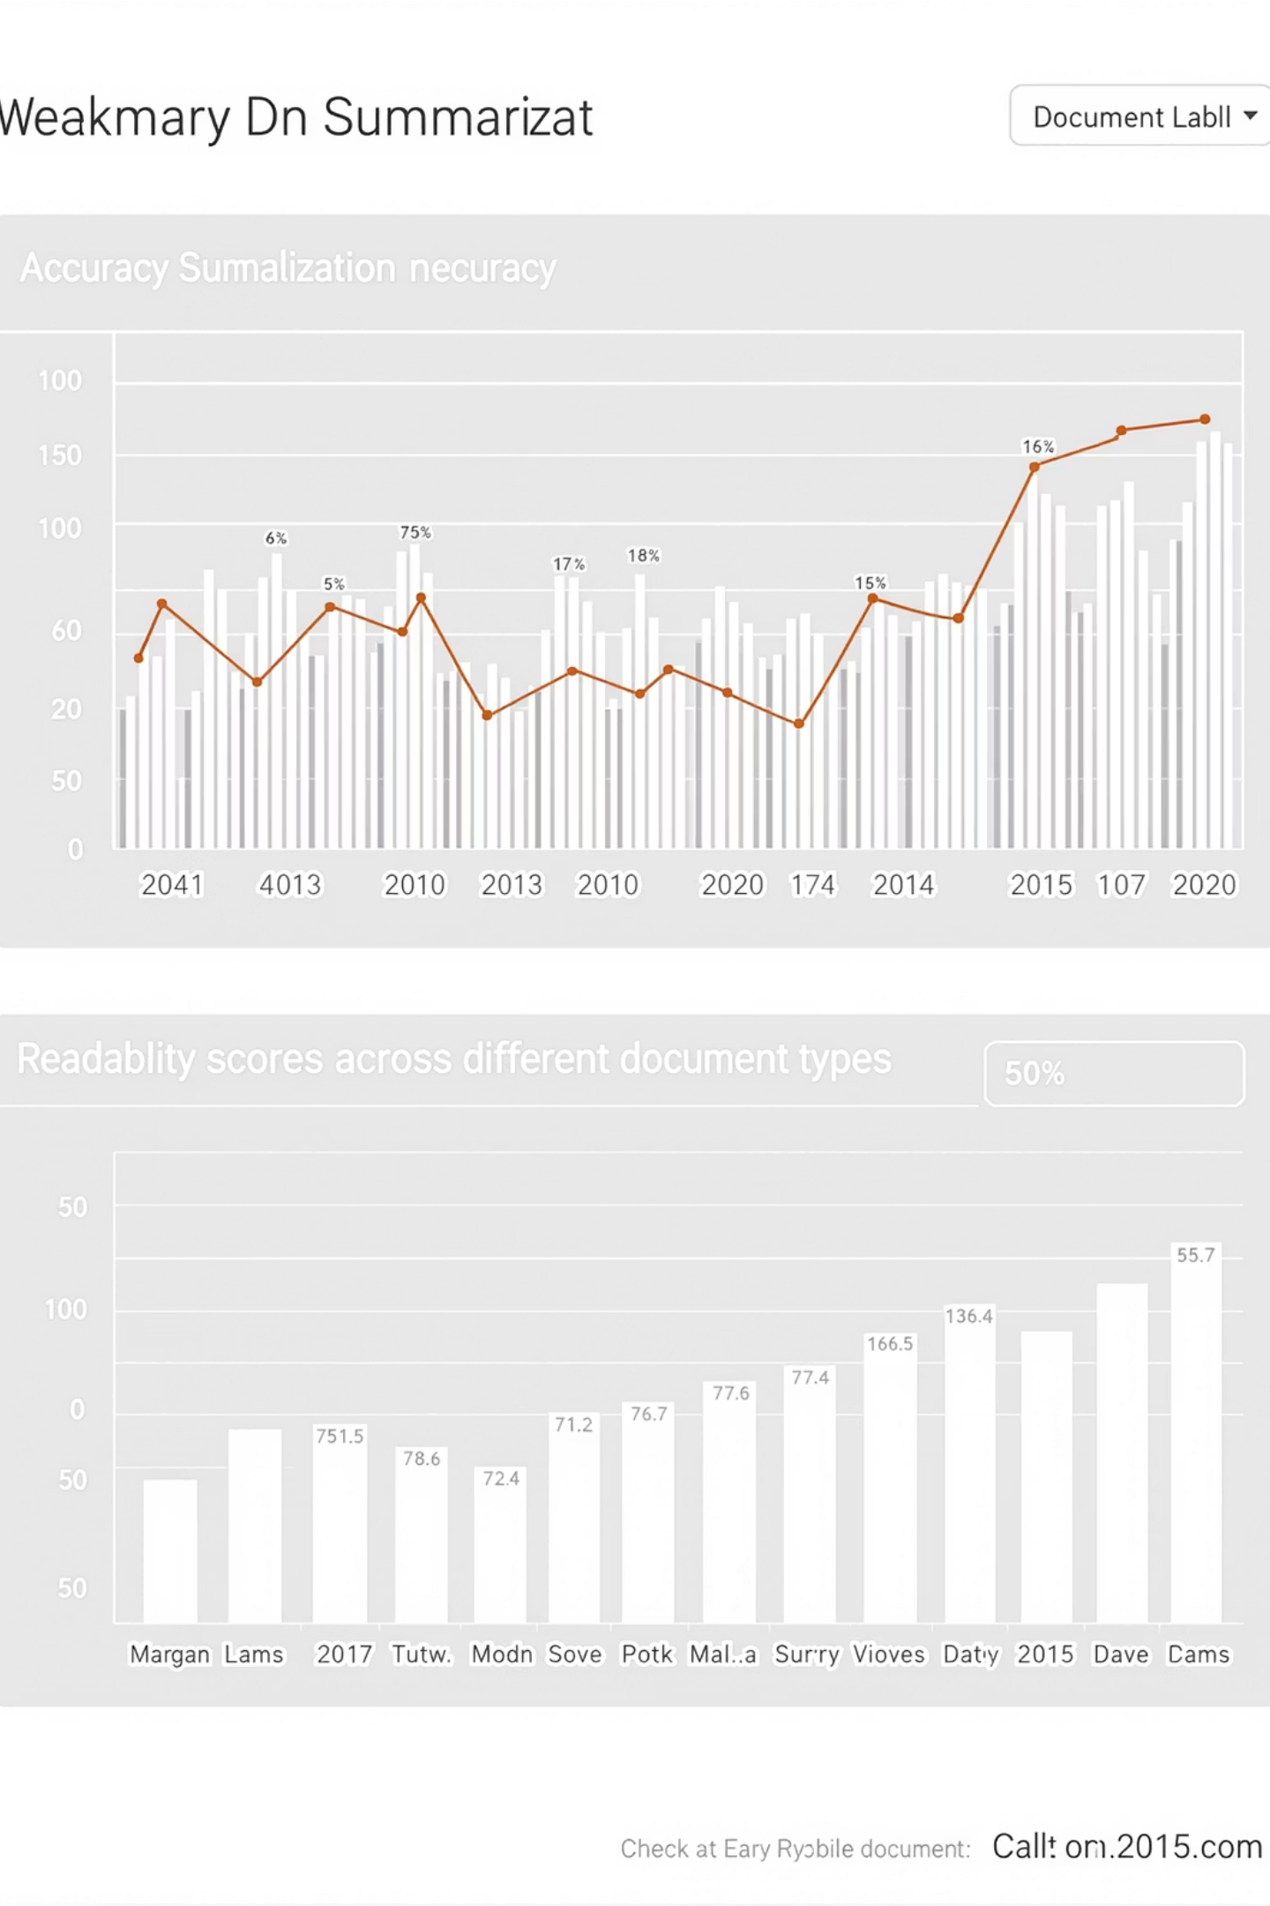
Evaluating Success
Metrics that matter to users
Fidelity to original:
- ROUGE-1 : General relevance
- ROUGE-2 : Fair level of contextual accuracy
- ROUGE-L: Maintains logical flow & sequencing
- BLEU: Reasonably fluent and understandable
- F1-Score: Solid in capturing key points while avoiding extra, irrelevant content
-
Readability:
Average reading time reduction: 70%
Feedback loop:
Adoption rate
User satisfaction
We track impact through both objective metrics and business outcomes. A tool that’s only accurate but unreadable doesn’t help. Ours balances both.
The metrics observed during training, testing and validation encourages us to roll out for Pilot implementation
Notes:
How do we know it works? We track both ML metrics and business KPIs:
Entity accuracy ensures facts are preserved
Reading time reduction validates time savings
ROUGE scores give us fidelity measures
And finally, user feedback confirms usability This dual-lens approach ensures the tool doesn’t just work—it works for people

Slide 9

Managing Risks
Accuracy Concerns
Entity-level validation with fallback to original text
Data Security
Self-hosted on cloud VPC with role-based access
Human Control
Override capability and comprehensive audit logs
Trust and transparency built into the design
We anticipated real-world risks and embedded mitigation measures at the design level—especially to ensure trust, auditability, and transparency.
Notes:
With any intelligent system, risks must be addressed:
Hallucinations: We detect and flag unverified entities
Privacy: The model runs on internal infrastructure, no data leaves
Trust: Users can validate or override summaries where needed The design is proactive—not reactive—when it comes to compliance, transparency, and human review

Slide 10
Implementation Approach
Initial Pilot
Domain Fine-tuning
1
Customize model for company-specific documents
Use Case: QA Handover Summarization
Pilot Result: 50% reduction in review time and improved cross-team clarity
Learning Phase: Feedback loop from QA and Engineering teams to fine-tune model tone & context sensitivity
Stakeholder Testing
Demos and usability feedback sessions
2
Phased Expansion
TechOps summaries (incident/shift logs)
Compliance narratives (audit notes, control documentation)
Engineering design briefs
Others…
Technical Readiness
API and dashboard preparation
Enterprise Launch
Rollout with phased expansion
With a pragmatic and measurable rollout plan, business teams will be in the driver’s seat
Notes:
We suggest a three-phase approach:
Pilot Phase: Focused rollout in QA and tech ops
Tuning Phase: Learn from real-world usage, improve
Scale Phase: Expand to onboarding, IT compliance, cross-functional teams We will enable dashboards, feedback capture, and training along the way to support adoption. Business users stay in control throughout.

Slide 11
Implementation Aspects
Deployment Approach:
Hosted on Secure Cloud (AWS/Azure/GCP)
Auto-scalable container-based microservice
Available via enterprise API or dashboard interface
API based integration into enterprise workflows as required
Operational Considerations
Cost:
Minimal—comparable to running lightweight NLP inference on low-tier GPU instances
Estimated under $100/month for initial scale
Maintenance:
Low overhead; periodic fine-tuning and feedback integration
Compatible with internal data policies and IT controls
An enterprise service that will run securely in the cloud, scale based on usage, and require minimal overhead to operate and maintain. The payoff—clarity and speed—far outweighs the small cost.
Notes:
This solution is designed for seamless enterprise deployment. It runs securely on cloud platforms like AWS, Azure, or GCP as a lightweight, containerized microservice. It can be accessed via an API or a simple dashboard and integrates easily into existing workflows.
From a cost perspective, the infrastructure is extremely efficient—estimated at under $100 per month at initial scale. Maintenance is minimal, requiring only occasional fine-tuning based on user feedback.
Overall, it’s a low-overhead, secure, and scalable solution with a very small footprint—ideal for production use across departments.

Slide 12

Thank You for your time & attention
Let's Summarize Smarter
Transform how your teams communicate, read, and act across the enterprise
Notes:
To summarize: This is a secure, smart, and simple-to-adopt summarization engine that helps your people focus on what matters. Let’s make how we read—and act—smarter. Thank you.

